Slide 1
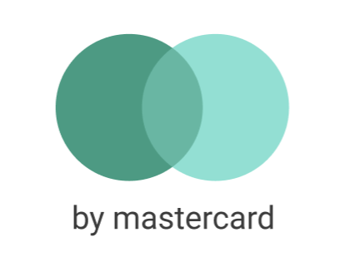
GreenWallet
HCIsland
Your green initiative
Notes:
Narrator(Toby): Welcome, everyone. We as team HCIsland are students of FH Salzburg, and during the hackathon we were tackling the challenge of promoting cashless payment and local sustainable tourism. So we created the App GreenWallet which we branded as an innovation by Mastercard. So lets directly start with a User Journey together with our user Nina,

Slide 2
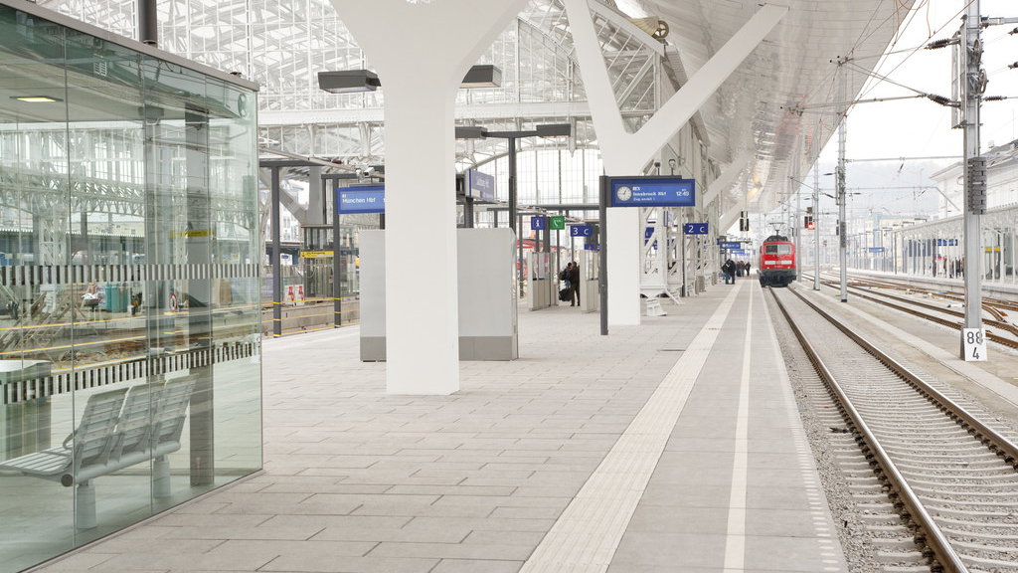


Notes:
Nina travelles around Austra with her interrail pass. As she isn’t good with planning she doesn’t quite know what to do now after the arrived in Salzburg

Slide 3
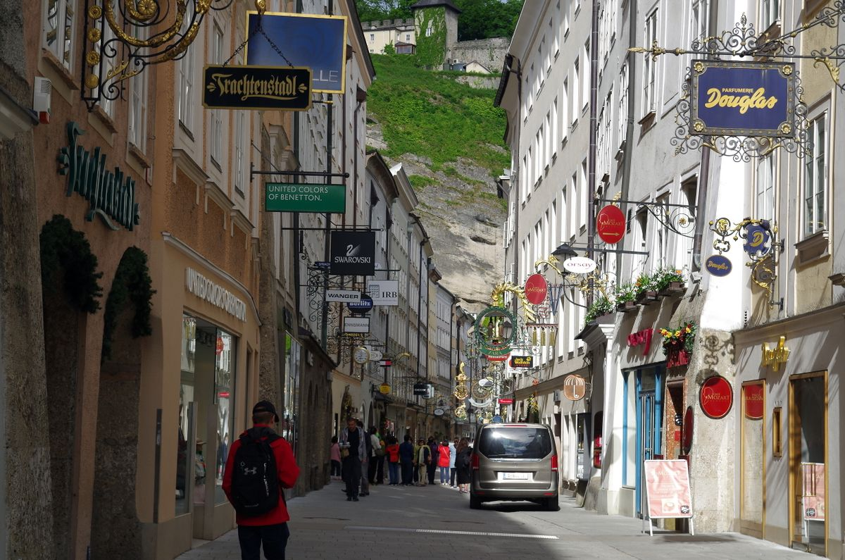
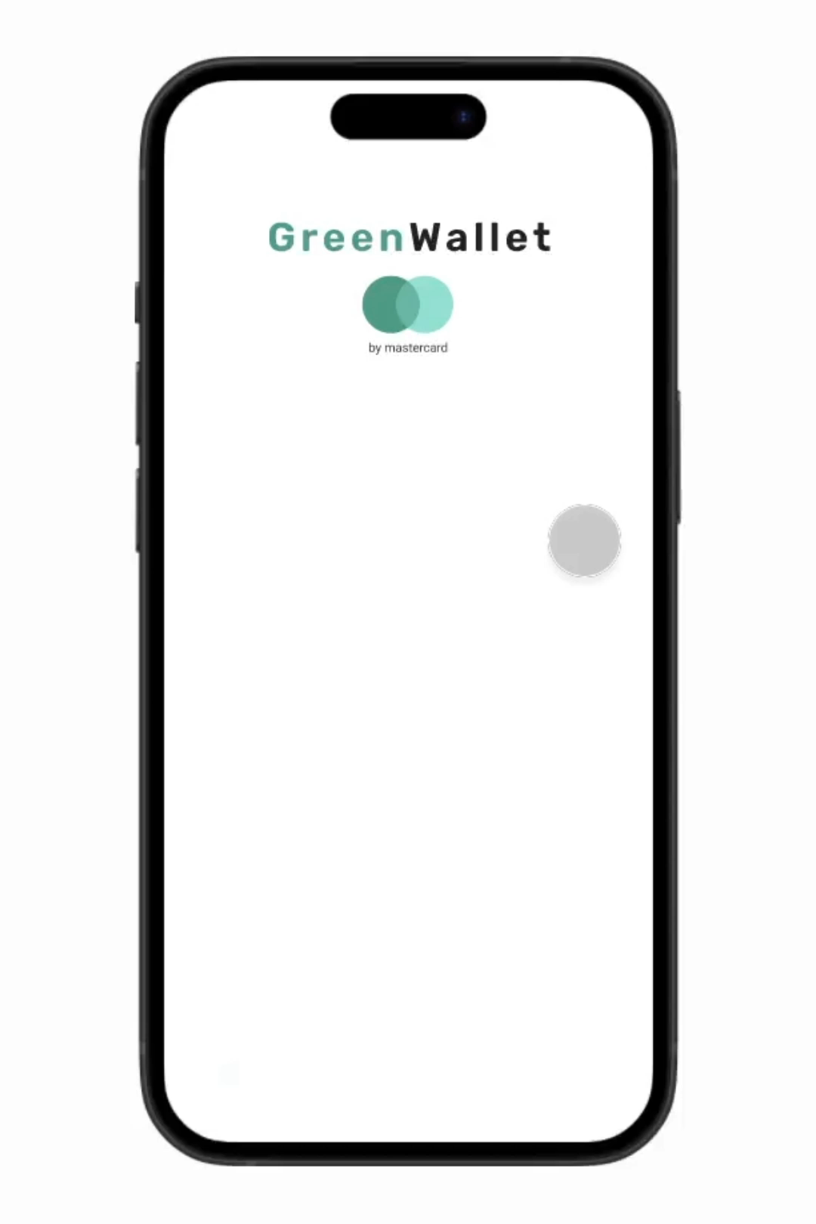
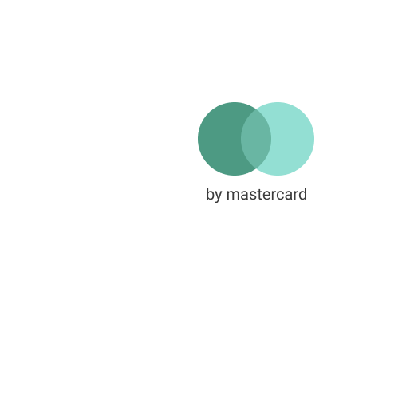
Notes:
Goes to the old town when she remembers her new App GreenWallet and starts it.

Slide 4

Notes:
Greeted with a map that shows many changing discounts from local strores. But nina realy wants a coffee now, so she finds Caffe Schatz which has a greate offer 2 for 1 pastries.

Slide 5

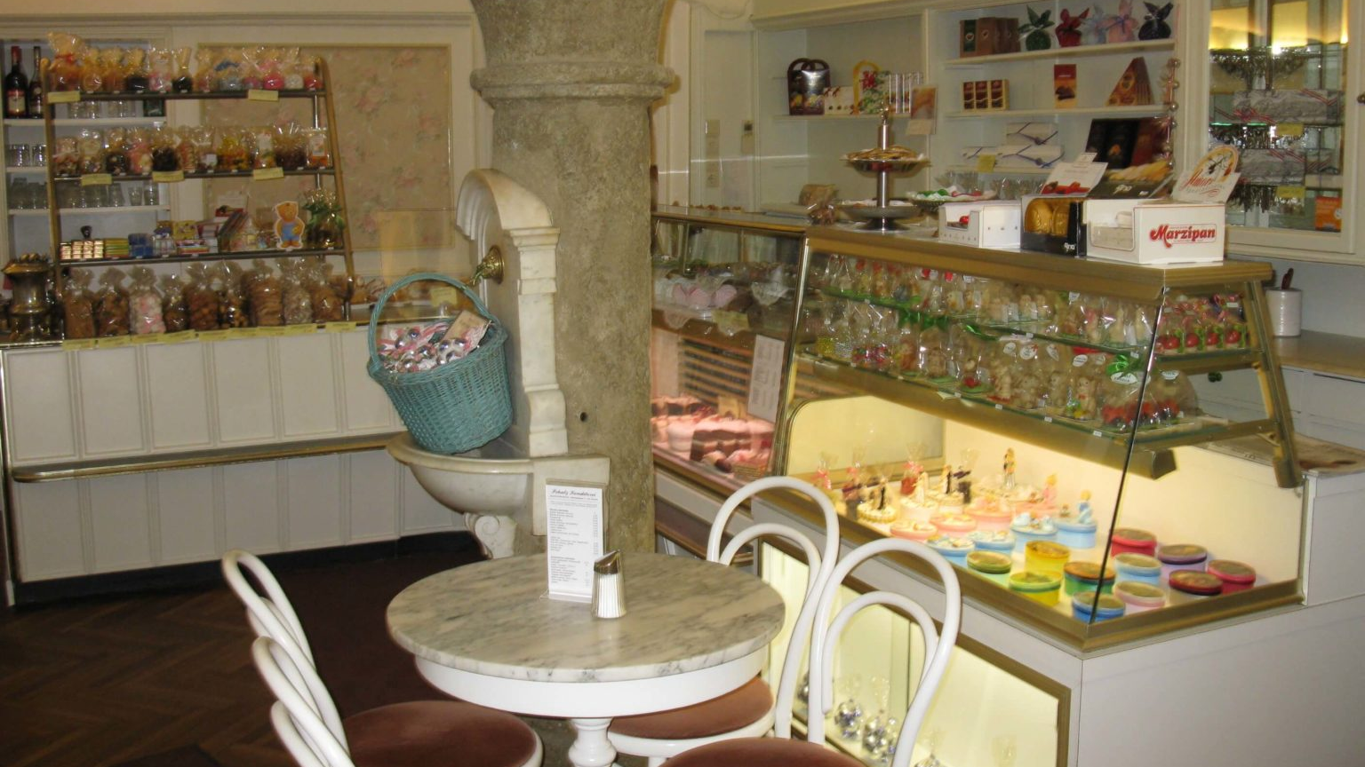

Notes:
Goes there, is nicely greeted by the shop owner paul and looks at all the delicious pastries and selects to buy two topfenstrudel

Slide 6
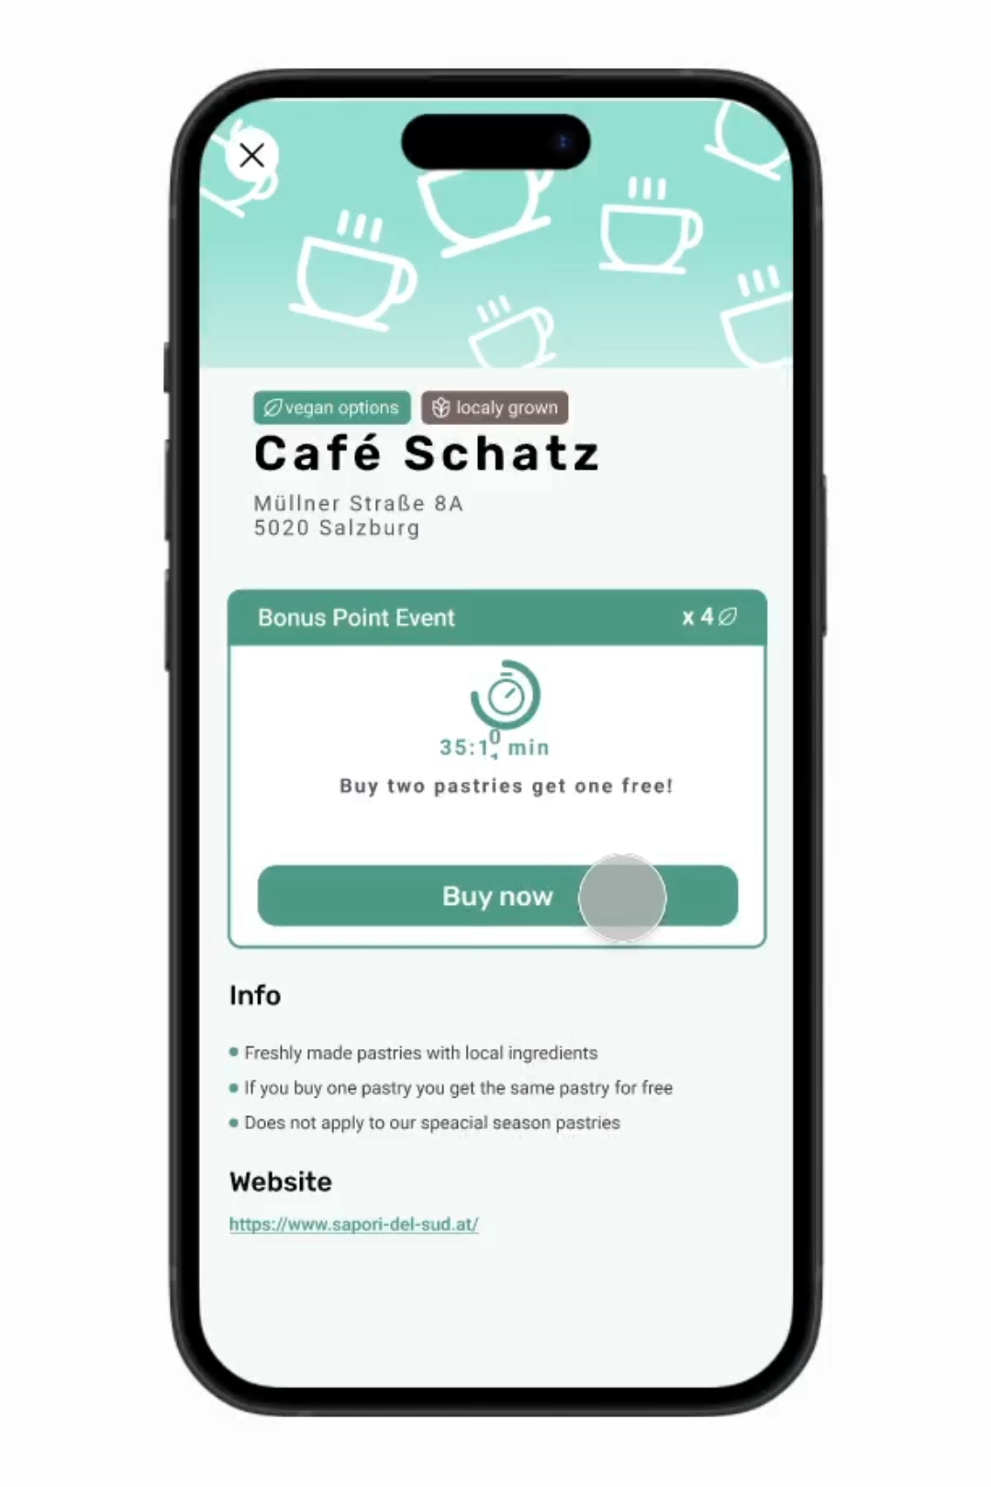

Slide 7
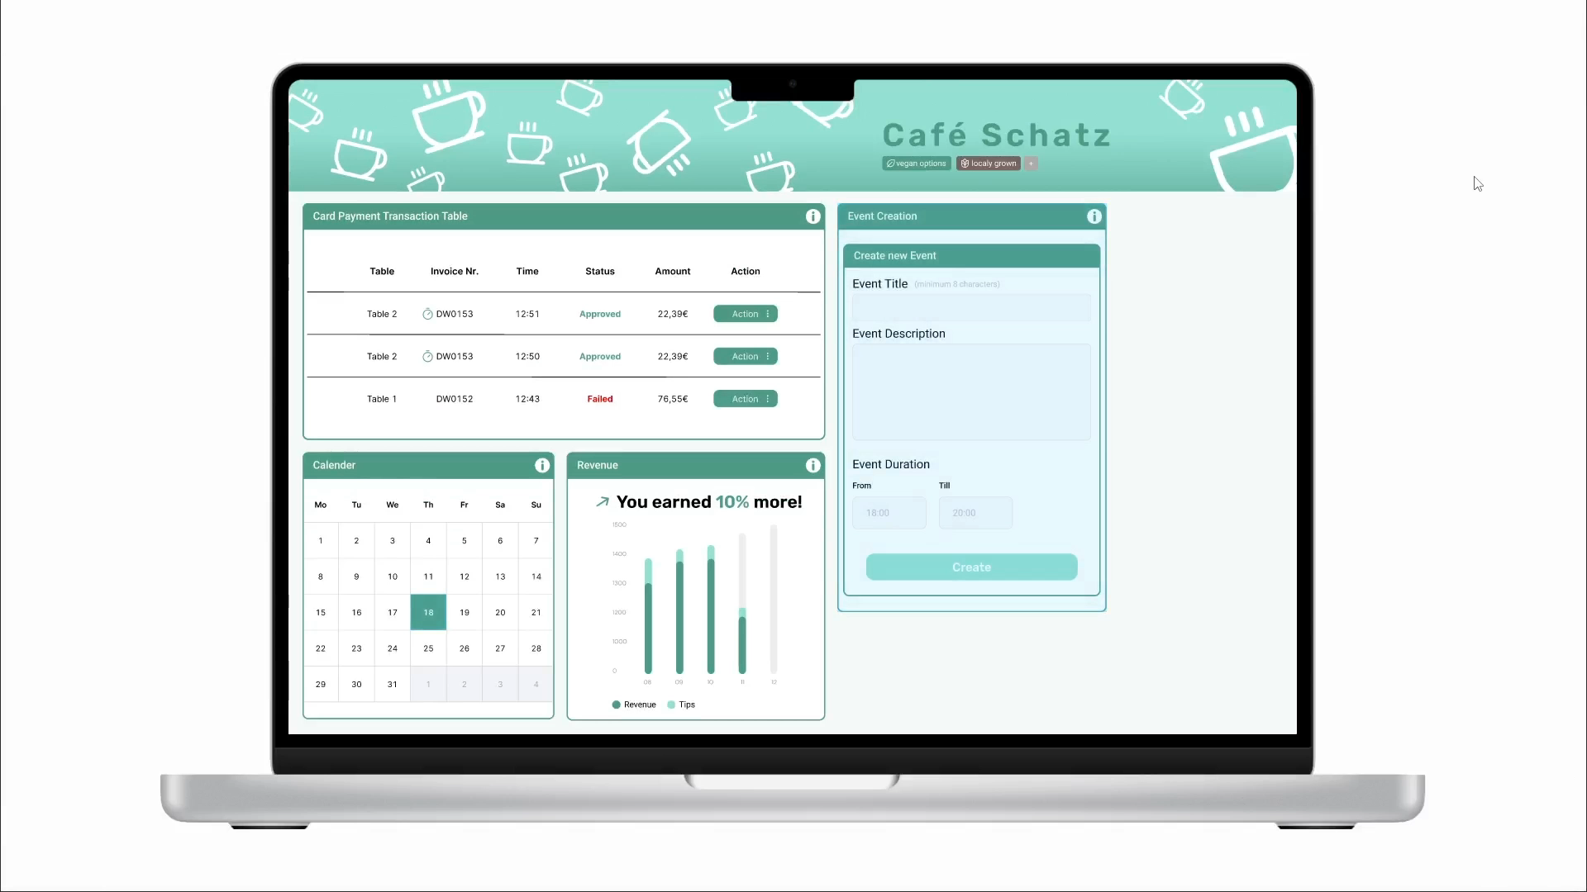
Notes:
But the system if not only great for Nina, also Paul provits from it, as he gets a system where he directly sees his earrings, and can compare them with other dates. He also of course can create new discount events for green wallet app. Special about these events are, that the time and location where new discounts pop-up is smartly steered by the backend of the system ensuring a more equal distribution of tourists. This means for example if a lot of tourists are at the moment at Mirabel Garten in Salzburg, the system detects this and starts discount events at another less crowded place maybe near Salzach.

Slide 8
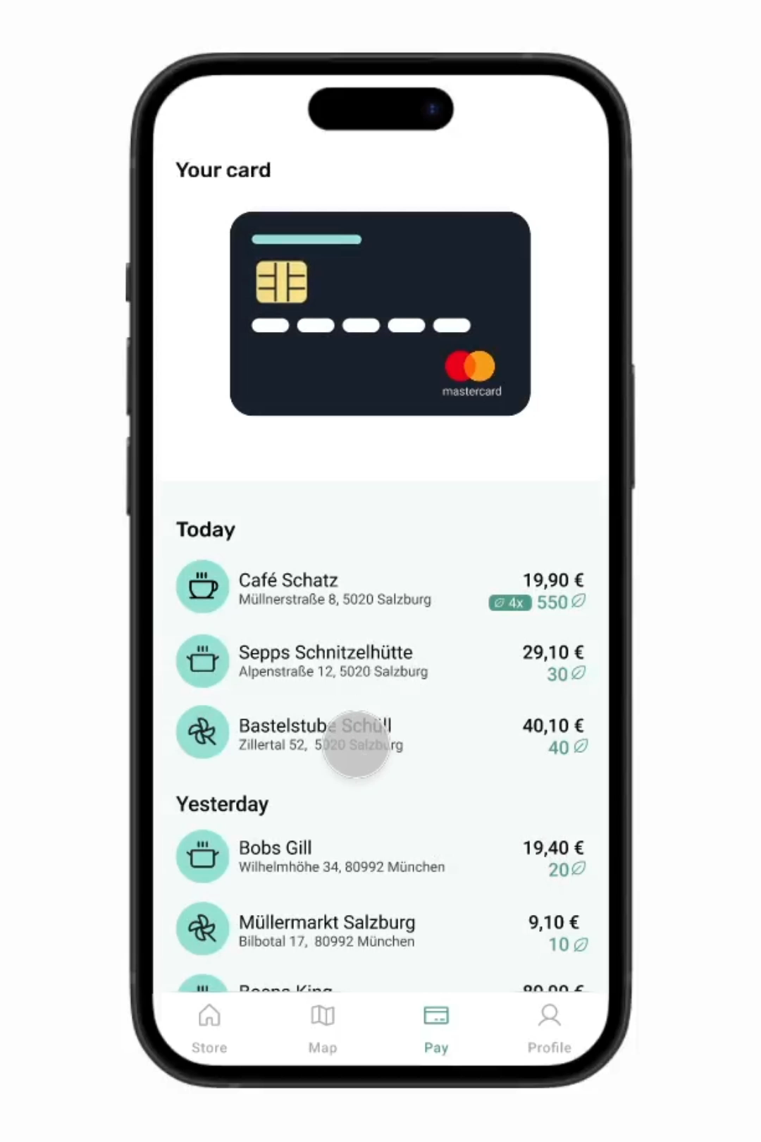
Notes:
Okay but lets go back to Nina: She didn’t just get a discount, but with her Greenwallet bonus points she got, she can also support Green and social Initiatives. Here Nina decides to support the climate through planting a tree.

Slide 9




Benefits
Mastercard
Users
Owners
Tourism regions
Plant trees
Discover new places
More equal distribution of people
Improved Image
Attract more customers
Notes:
So in the end you can say everybody is happy. It’s a win win situation where cashless payment is promoted and companies like Mastercard can improve their images. Users are happy was they get discounts, collect points and can do something good for our planet all while discovering new places. The shopowners are happy as they get a new way of attracting customers and the tourism regions are happy as the solution contributes to a fairer distribution of tourists.

Slide 10
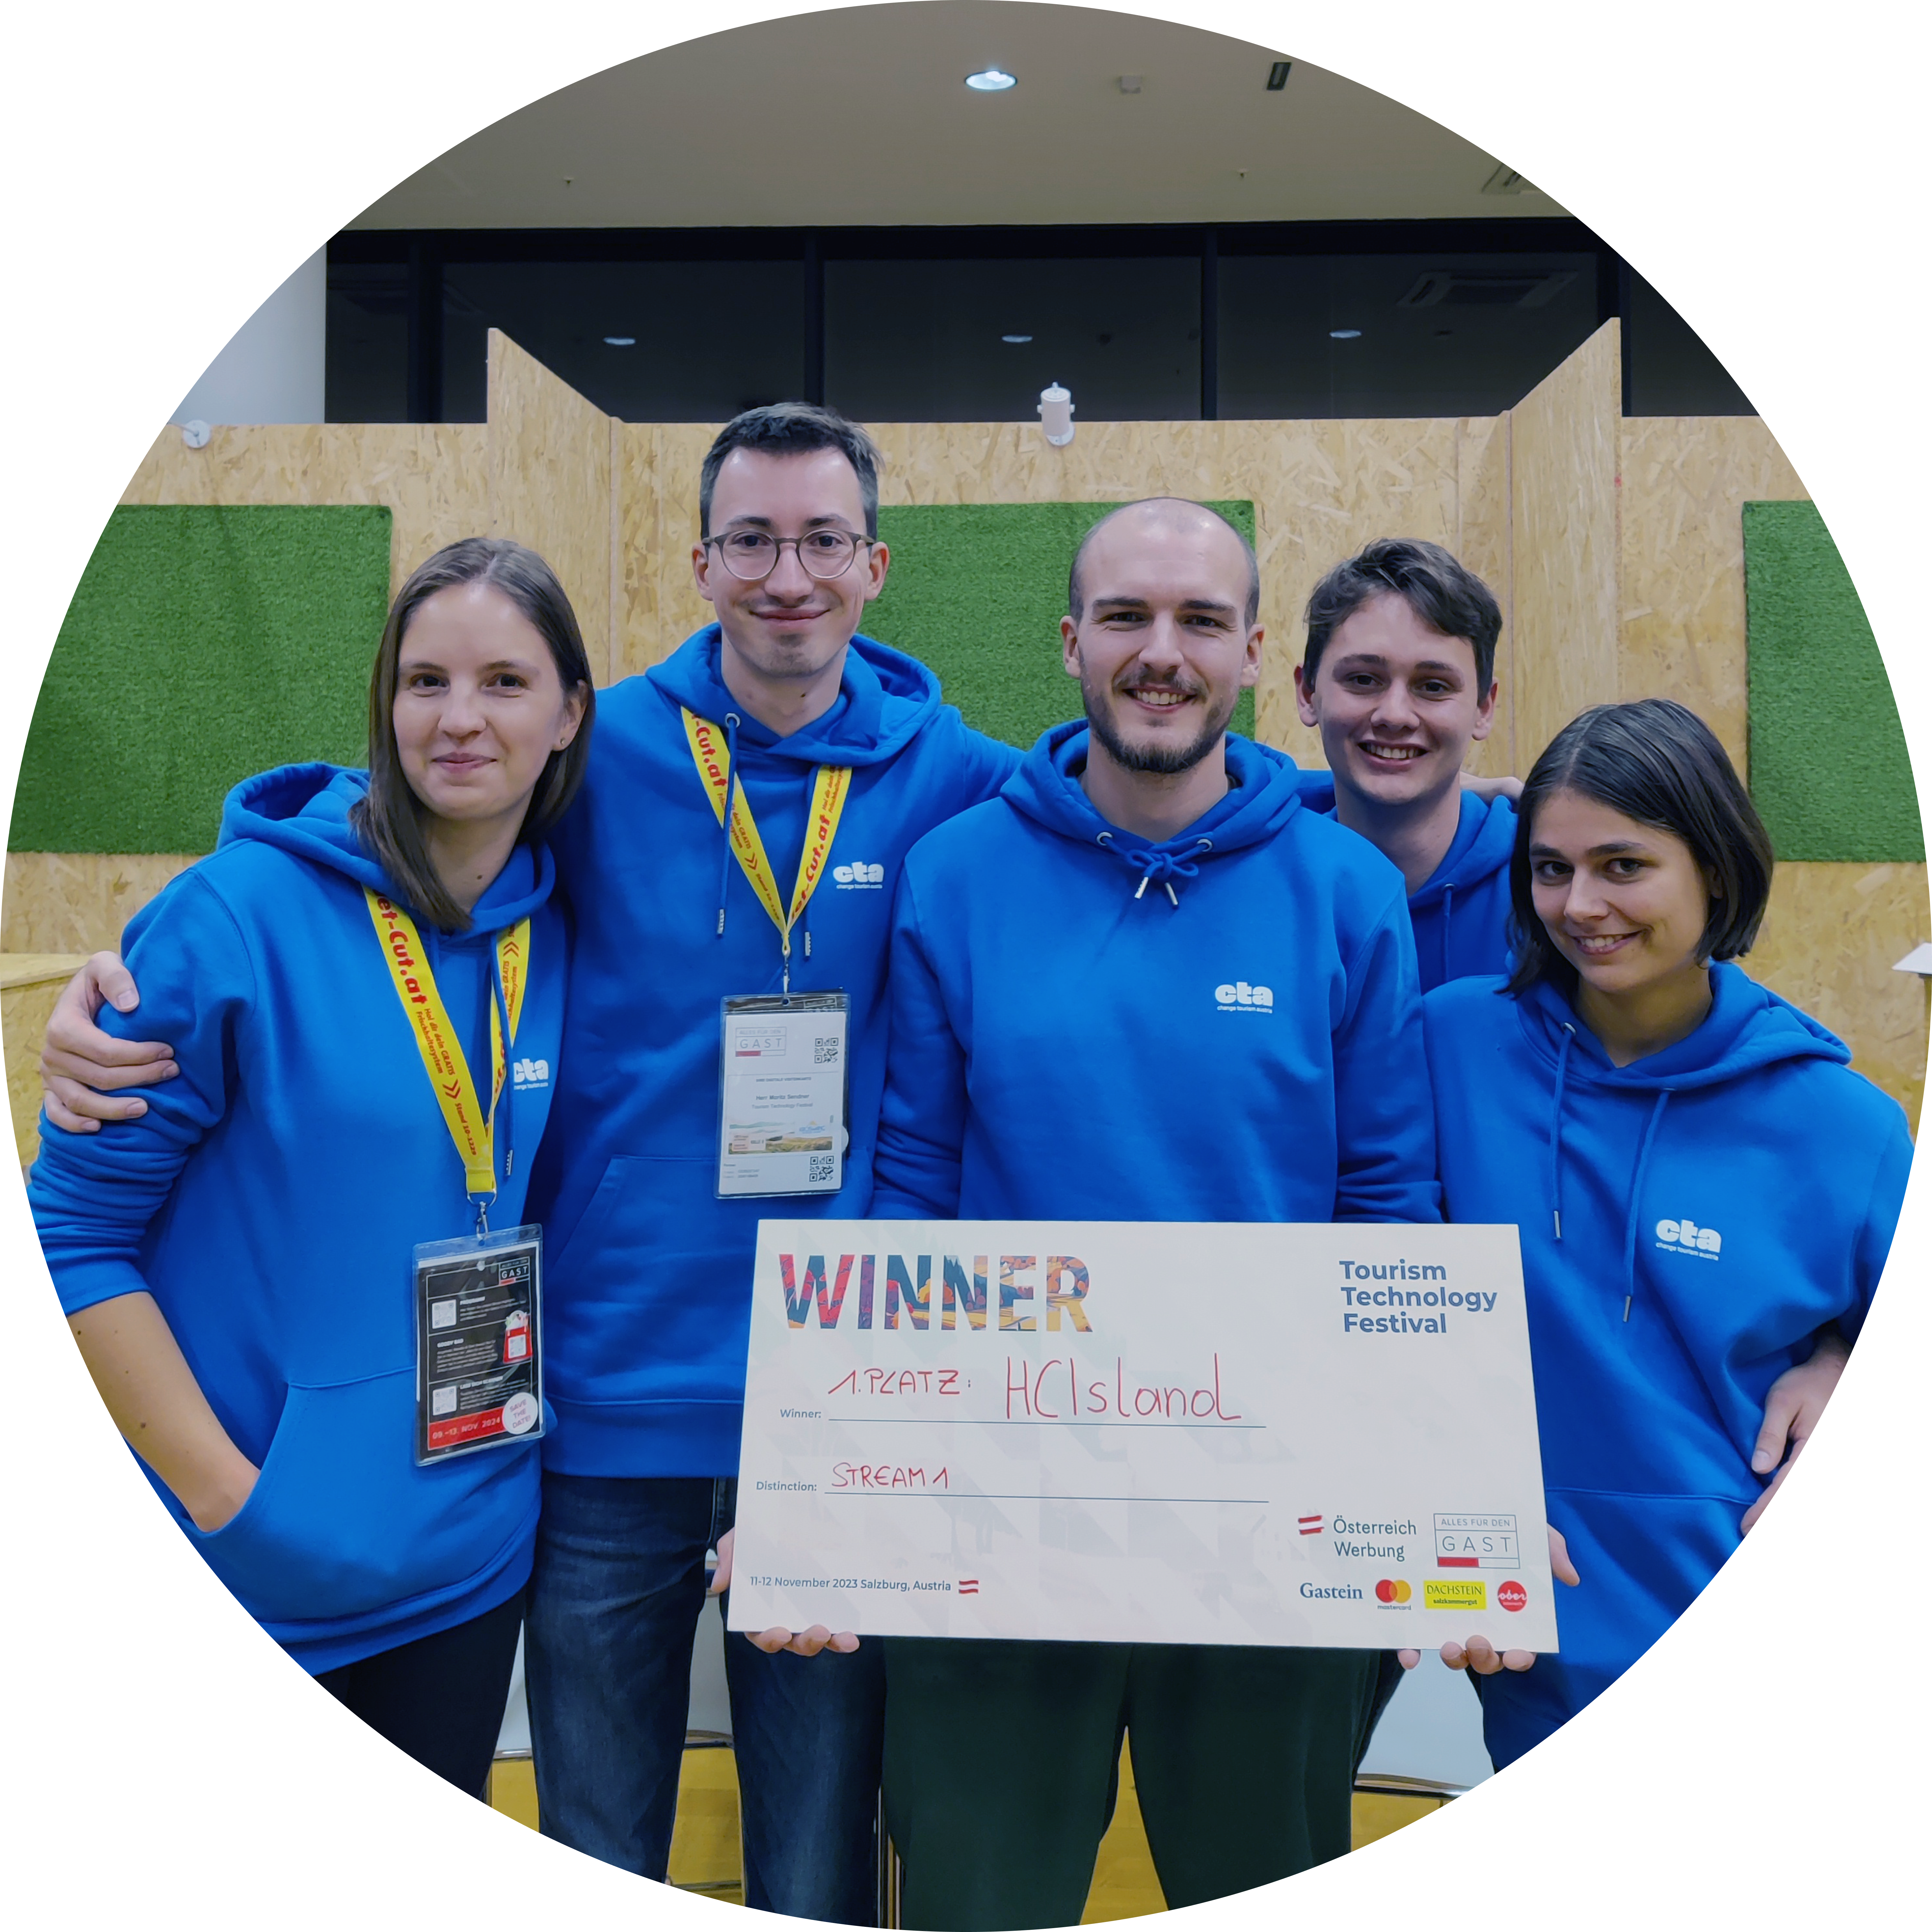
HCIsland

